Slide 1
Ultralite Coding
Spencer Lofing, Ben Finnerty, Tyler Hogenson, Max Maier, Nicholas Walter

Slide 2
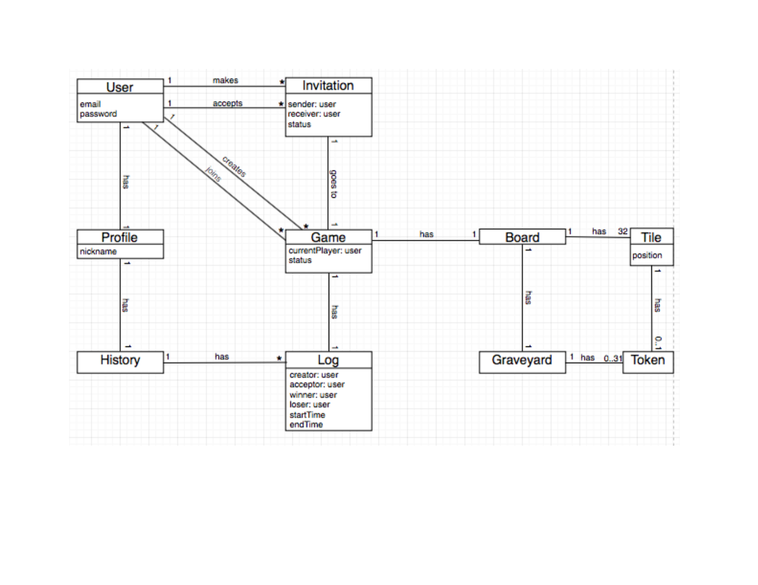
Updated Domain Model

Slide 3
Sequence Diagrams

Slide 4
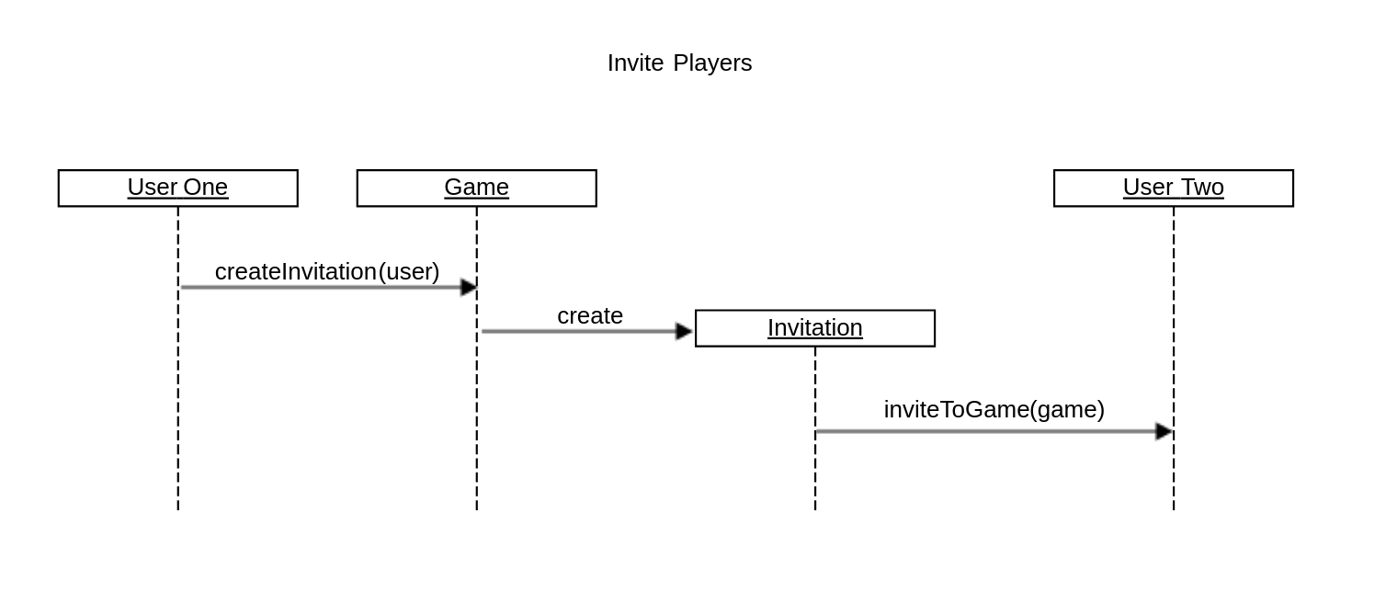
Invite Players

Slide 5
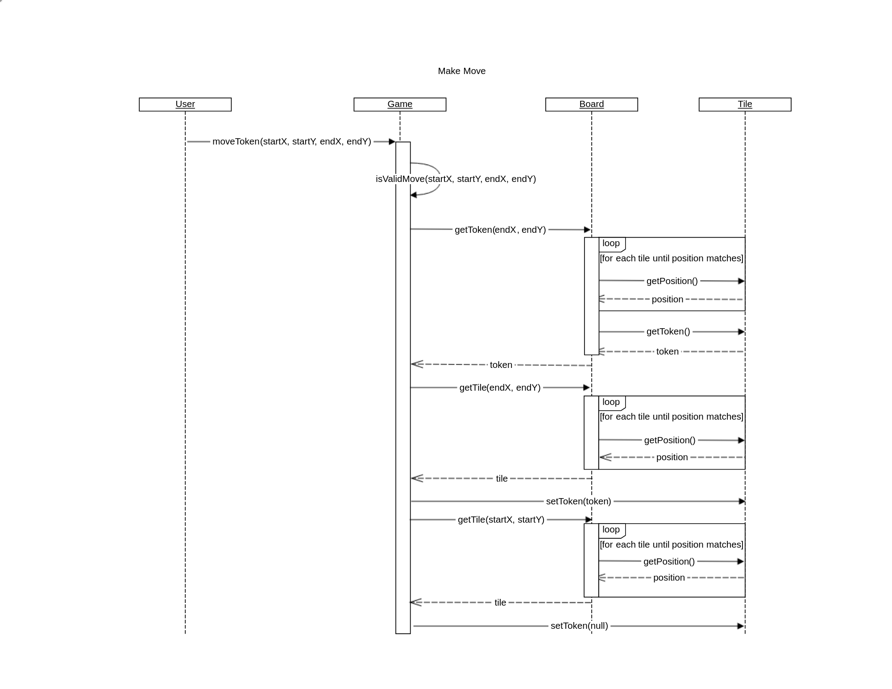
Make Move

Slide 6
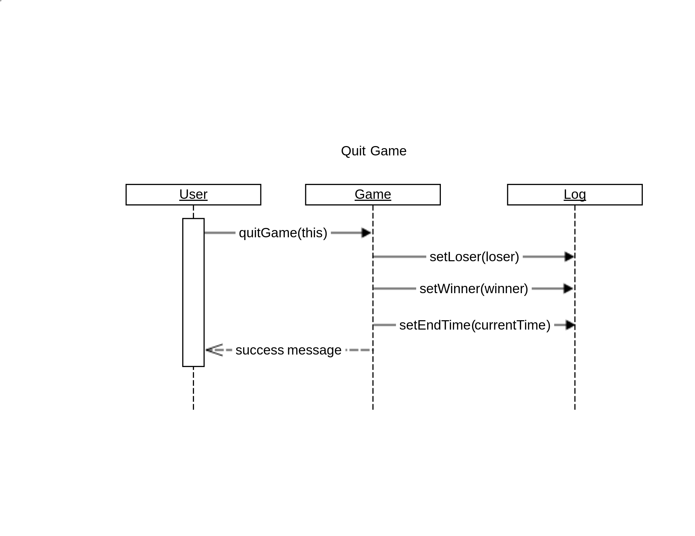
Quit Game

Slide 7
Design Class Diagram

Slide 8
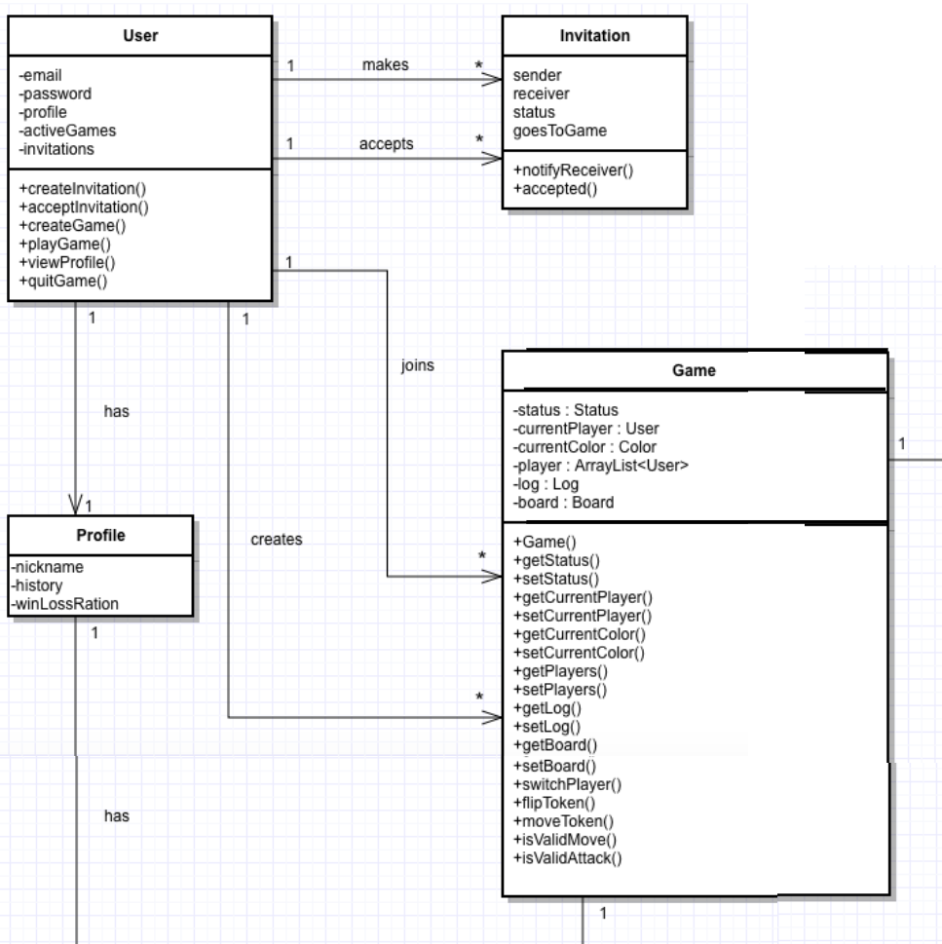
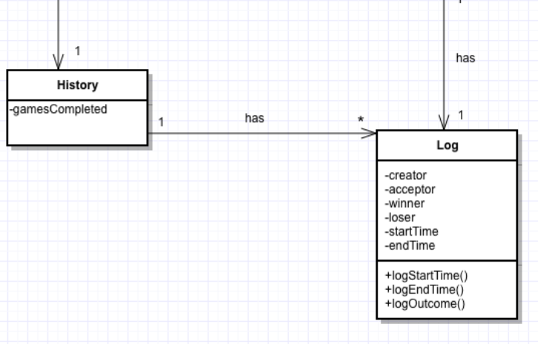

Slide 9
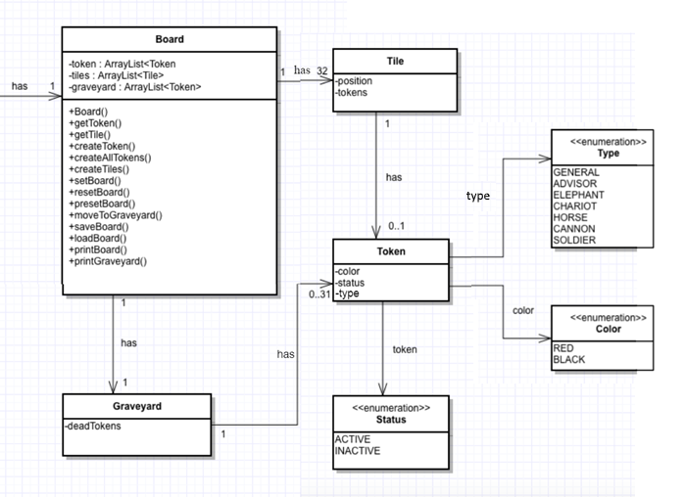

Slide 10
Demo

Slide 11
Questions?

